Slide 1
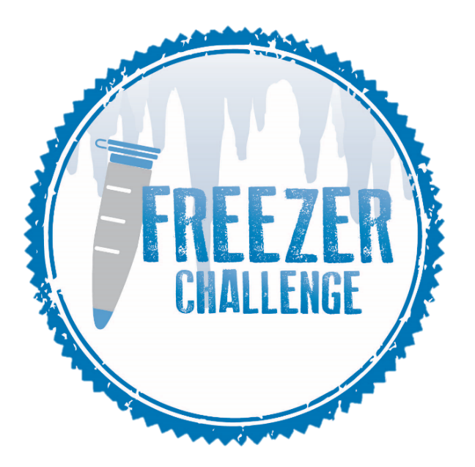
THE 2017 NORTH AMERICAN LABORATORY FREEZER CHALLENGE
About the 2017
Freezer Challenge
Freezer Challenge Focus Areas
The International Institute for Sustainable Laboratories (I²SL) and My Green Lab partnered to establish the North American Laboratory Freezer Challenge. Designed to optimize cold storage management practices in laboratories, the Freezer Challenge harnesses a spirit of competition and a scoresheet to target five areas of freezer management.
Good Management Practices
Freezer Challenge Participation
Laboratories of all sectors are invited to participate in the Freezer Challenge! Organize your team, select a creative team name, and start planning how you’ll complete the Freezer Challenge together!
Temperature Tuning
WHAT Should I know before I sign up?
Unit Retirements, Upgrades, and Unplugs
Who: All North American labs
Registration Deadline: January 15, 2017
Challenge: January 15 – May 1 (labs compete at their own pace)
Cost: NONE! But you must register online
Awards: Announced at the Boston I²SL Conference, October 2017
Questions? Contact info@mygreenlab.org | 424.354.1494
Cutting Edge Practices
THINK YOU’RE COOL ENOUGH?
sign up at www.freezerchallenge.org
Freezer and
Sample
Inventory
Presenting Sponsors
Gold Sponsor
Bronze Sponsors

